Slide 1

Scalable Machine Learning
For Smarter Applications

Slide 2

Hank Roark
Data Scientist / Hacker
hank@h2o.ai
@hankroark
https://www.linkedin.com/in/hankroark

Slide 3
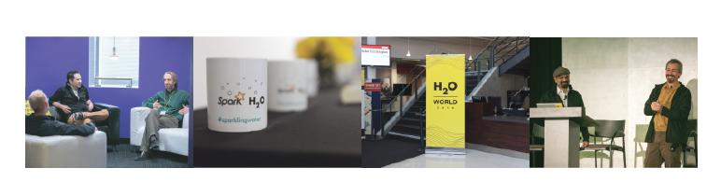
H2O.ai Overview
Founded: 2011 venture-backed, debuted in 2012
Product: H2O open source in-memory prediction engine
Team: 34
HQ: Mountain View, CA
SriSatish Ambati – CEO & Co-founder (Founder Platfora, DataStax; Azul)
Cliff Click – CTO & Co-founder (Creator Hotspot, Azul, Sun, Motorola, HP)
Tom Kraljevic – VP of Engineering (CTO & Founder Luminix, Azul, Chromatic)
H₂O.ai Machine Intelligence

Slide 4
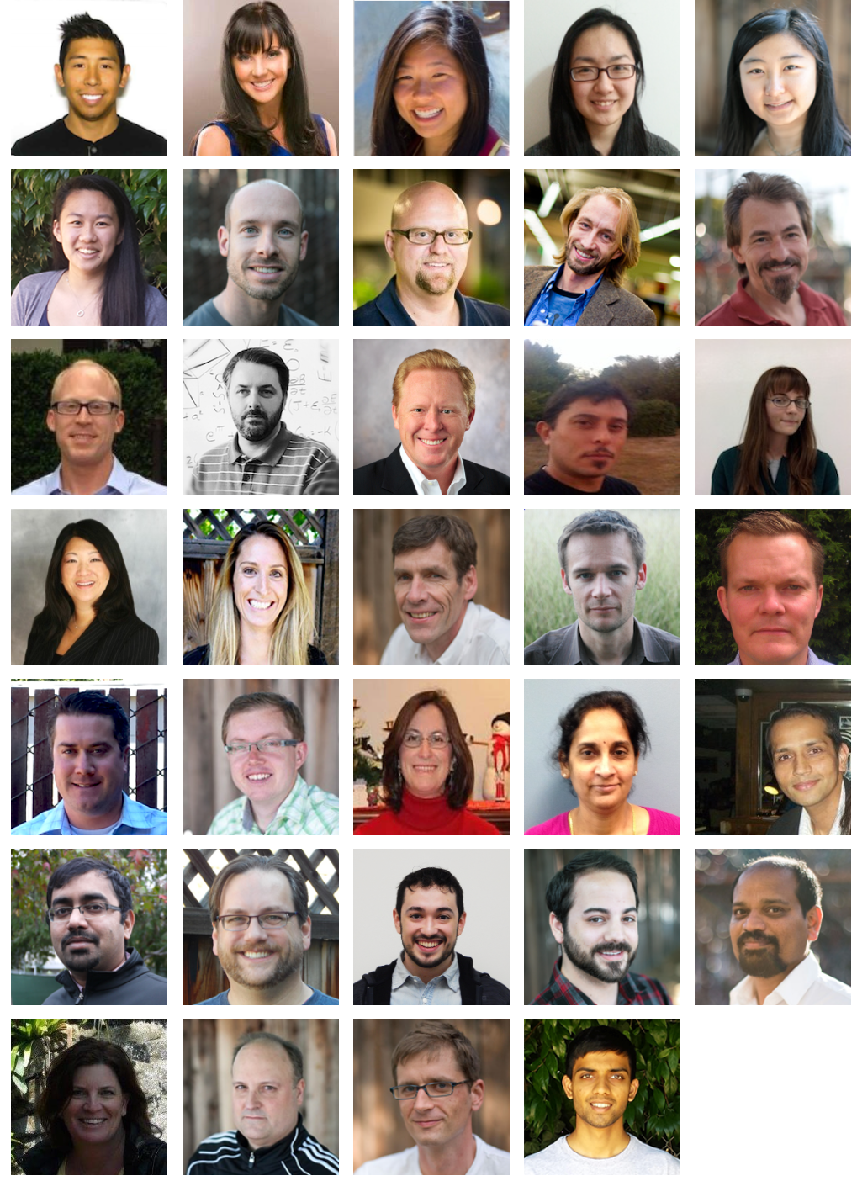
Distributed
Systems Engineers
Making ML Scale!
TBD. Customer Support
TBD
Head of Sales
H₂O.ai Machine Intelligence

Slide 5


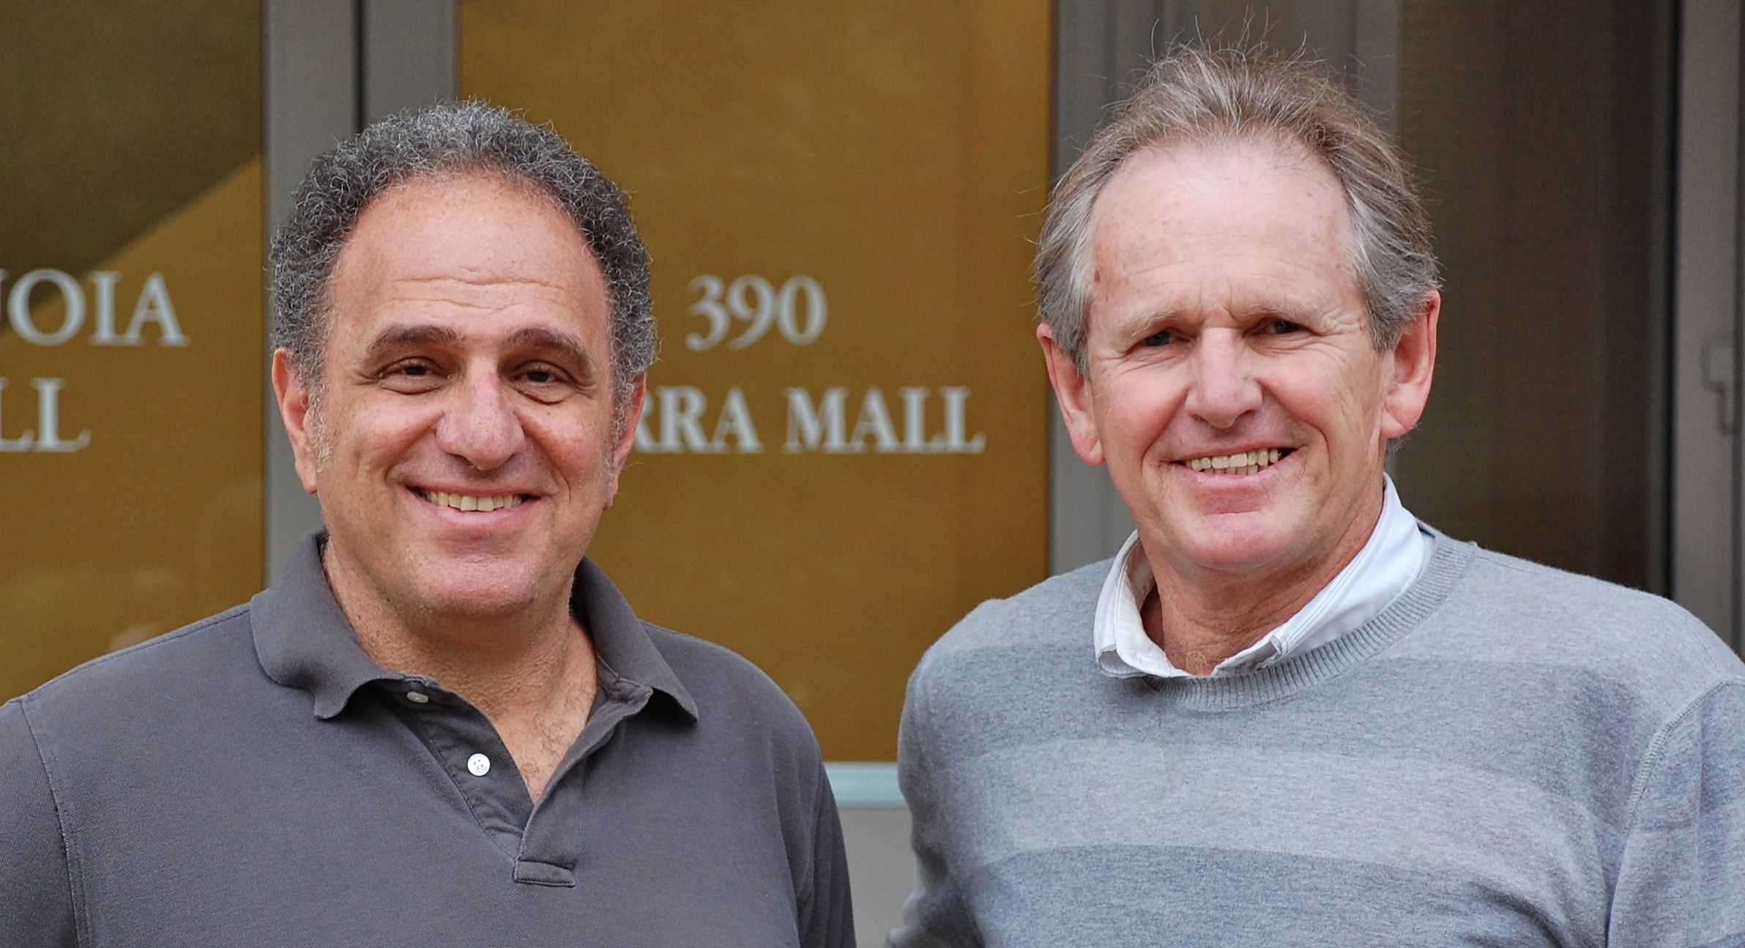
cientific Advisory Council
Stephen Boyd
Professor of EE Engineering
Stanford University
Rob Tibshirani
Professor of Health Research
and Policy, and Statistics
Stanford University
Trevor Hastie
Professor of Statistics
Stanford University
H₂O.ai Machine Intelligence

Slide 6
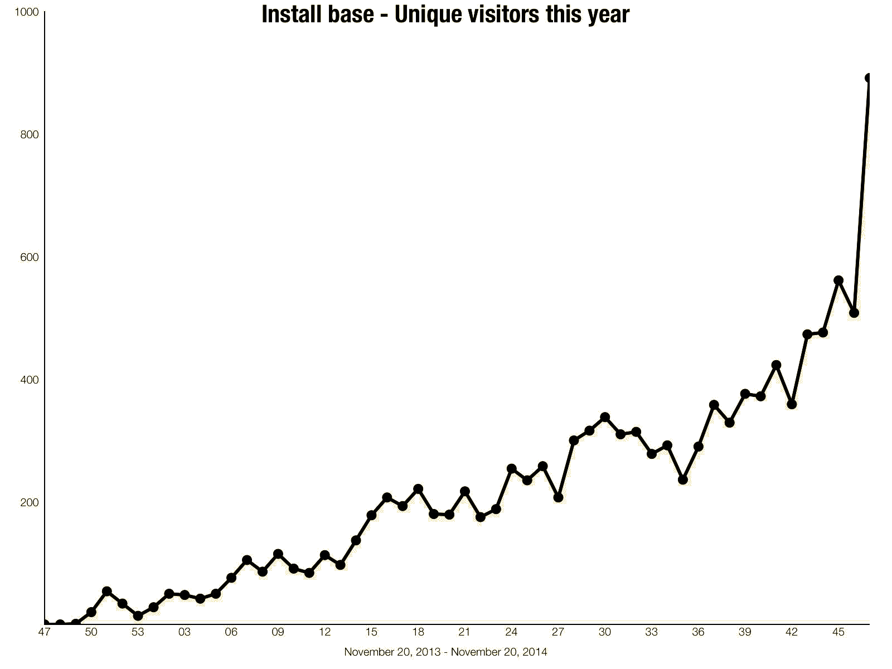
2014 Adoption and Growth
120 Meetups
15,000 Attendees
10,000 Installations
1,800 Corporations
1st annual H2O World Conference
H₂O.ai Machine Intelligence
weeks

Slide 7
What is H2O?
Math Platform
Open source in-memory prediction engine
Parallelized and distributed algorithms making the most use out of multithreaded systems
GLM, Random Forest, GBM, PCA, etc.
API
Easy to use and adopt
Written in Java – perfect for Java Programmers
REST API (JSON) – drives H2O from R, Python, Excel, Tableau
Big Data
More data?Or better models? BOTH
Use all of your data – model without down sampling
Run a simple GLM or a more complex GBM to find the best fit for the data
More Data + Better Models = Better Predictions
H₂O.ai Machine Intelligence

Slide 8
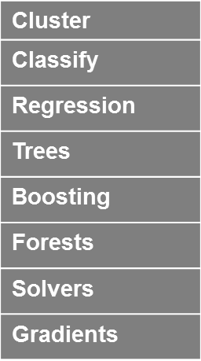
Python
R
Tableau
JSON
Java
Excel
Scala
H₂O Prediction Engine
On Premise
On Hadoop & Spark
On EC2
SDK / API
Nano Fast Scoring Engine
Rapids Query R-engine
In-Mem Map Reduce
Distributed fork/join
Deep Learning
Per Node
2M Row ingest/sec
50M Row Regression/sec
750M Row Aggregates / sec
Memory Manager Columnar Compression
Ensembles
H₂O.ai Machine Intelligence
HDFS
S3
SQL
NoSQL

Slide 9
Algorithms on H2O
Supervised Learning
Generalized Linear Models: Binomial, Gaussian, Gamma, Poisson and Tweedie
Cox Proportional Hazards Models
Naïve Bayes
Statistical Analysis
Distributed Random Forest: Classification or regression models
Gradient Boosting Machine: Produces an ensemble of decision trees with increasing refined approximations
Ensembles
Deep learning: Create multi-layer feed forward neural networks starting with an input layer followed by multiple layers of nonlinear transformations
Deep Neural Networks

Slide 10
Algorithms on H2O
Unsupervised Learning
K-means: Partitions observations into k clusters/groups of the same spatial size
Clustering
Principal Component Analysis: Linearly transforms correlated variables to independent components
Dimensionality Reduction
Anomaly Detection
Autoencoders: Find outliers using a nonlinear dimensionality reduction using deep learning

Slide 11
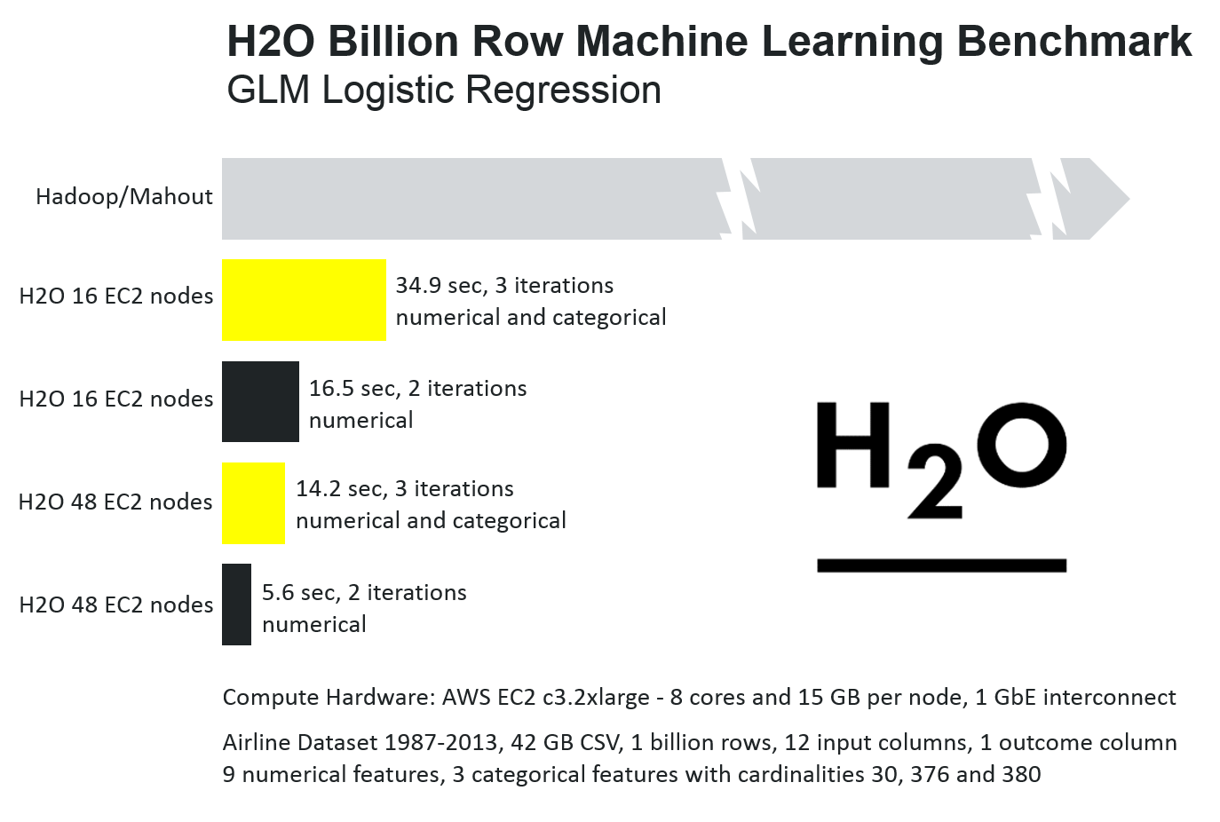
H₂O.ai Machine Intelligence

Slide 12
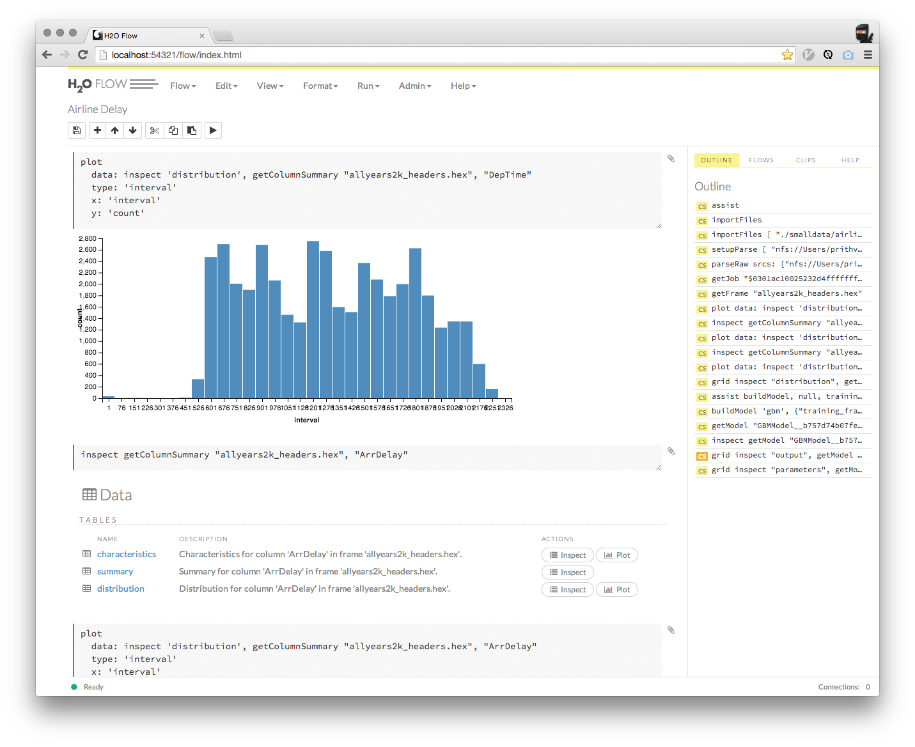
H2O Flow
A Web-based interactive computing environment for Big Data Machine Learning
New web interface of H2O
Model comparisons
Mixed environment for
Coffeescript
Text & Markdown
Charts & Visualization (more to come)
R/Spark/Python code (coming soon)
Mathematics Equations (coming soon)
Video & Rich Media

Slide 13
H2O Software Stack
Customer Algorithm
JavaScript
R
Python
Excel/Tableau
Flow
Network
Rapids Expression Evaluation Engine
Scala
Customer Algorithm
GLM
GBM
RF
Deep Learning
K-Means
PCA
Parse
In-H2O Prediction Engine
Customer Algorithm
Fluid Vector Frame
Job
Distributed K/V Store
MRTask
Non-blocking Hash Map
Fork/Join
Spark
Hadoop
Standalone H2O

Slide 14

Reading Data from HDFS into H2O with R
STEP 1
h2o_df = h2o.importFile(“hdfs://path/to/data.csv”)
R user

Slide 15
Reading Data from HDFS into H2O with R
STEP 2
2.3
Initiate distributed ingest
H2O Cluster
2.2
R
HTTP REST API request to H₂O
has HDFS path
H₂O
H₂O
h2o.importFile()
H₂O
2.1
R function call
2.4
Request data from HDFS
HDFS
data.csv
Notes:
Data never goes into or through R
R tells H2O what to do
R has a pointer to the big data that lives in H2O
Operations on the R object are intercepted using operator overleading and forwarded to H2O via the REST API
H2OFrame object in R is a proxy for the big data in H2O
R: df= H2O.imporrtFile(“hdfs://path/to/data.csv”)
h2o>_df is an H2OFrame object in R

Slide 16
Reading Data from HDFS into H2O with R
STEP 3
3.2
Distributed H₂O
Frame in DKV
H2O Cluster
3.3
R
Return pointer to data in REST API JSON Response
H₂O
h2o_df
H₂O
Frame
H₂O
Cluster IP
Cluster Port
Pointer to Data
H₂O
3.4
h2o_df object created in R
3.1
HDFS provides data
HDFS
data.csv
Notes:
Data never goes into or through R
R tells H2O what to do
R has a pointer to the big data that lives in H2O
Operations on the R object are intercepted using operator overleading and forwarded to H2O via the REST API
H2OFrame object in R is a proxy for the big data in H2O
R: df= H2O.imporrtFile(“hdfs://path/to/data.csv”)
h2o>_df is an H2OFrame object in R

Slide 17
R Script Starting H2O GLM
TCP/IP
HTTP
HTTP
Legend
REST/JSON
REST/JSON
/3/ModelBuilders/glm endpoint
Network layer
.h2o.startModelJob()
POST /3/ModelBuilders/glm
Job
REST layer
GLM algorithm
H2O - algos
h2o.glm()
GLM tasks
H2O - core
R script
Fork/Join framework
K/V store framework
User process
Standard R process
H2O process
H2O process

Slide 18
R Script Retrieving H2O GLM Result
TCP/IP
HTTP
HTTP
Legend
REST/JSON
REST/JSON
/3/Models endpoint
Network layer
h2o.getModel()
GET /3/Models/glm_model_id
REST layer
H2O - algos
h2o.glm()
H2O - core
R script
Fork/Join framework
K/V store framework
User process
Standard R process
H2O process
H2O process

Slide 19
H₂O – Sparkling Water
In-Memory | Big Data, Columnar
ML | 100x faster Algos
R | CRAN, API, fast engine
API | Spark API, Java MM
Community | Devs, Data Science
MLlib
H2O
SQL
H2ORDD
HDFS=DATA
H₂O.ai Machine Intelligence

Slide 20
Scalable Machine Learning
For Smarter Applications

